Slide 1
Video Game Sales & Engagement Analysis
Avanthi U C

Slide 2
📌 Problem Statement
The project aims to analyze and visualize video game sales and engagement data to uncover trends in game popularity, user behavior, and platform performance.
By merging sales and engagement data, we seek to offer insights into how game features, platforms, and genres influence sales, wishlists, and ratings. SQL will be used to structure and store the data, while Power BI/Streamlit dashboards will be developed to guide decision-making for game developers, marketers, and publishers.

Slide 3
BUSINESS USE CASES
Game Marketing Strategy:
Identify high-performing genres and platforms to target marketing efforts.
Analyze rating and wishlist trends to understand user preferences.
Product Development:
Evaluate how different game attributes (e.g., rating, genre, developer) relate to sales and engagement.
Determine the features that correlate with successful game launches.
Sales Forecasting:
Analyze past performance to forecast game demand.
Evaluate the impact of game ratings and wishlists on global sales trends.
Resource Allocation:
Focus development on platforms and genres with proven commercial success.
Detects regions or genres with lower saturation and high opportunity.

Slide 4
🛠 Tools & Technologies Used
  SQL (Data Querying)
  Streamlit (Web Dashboard)
  Power BI
  Python (Pandas, NumPy)

Slide 5
📊 INSIGHTS
Insights Gained:
🎮 Global sales peaked during major console generations ( 2008–2012 era).
📉 Sales declined after 2015 due to digital distribution shift.
🚀 Industry growth strongly aligned with new platform launches.
A small number of games generate a disproportionately large share of total revenue. Like Nintendo

Slide 6
🔎 Key Insights
Sales peaked during certain console generations
  Higher-rated games often show stronger sales correlation
  Certain platforms dominate specific years
  Genre trends shift over time

Slide 7
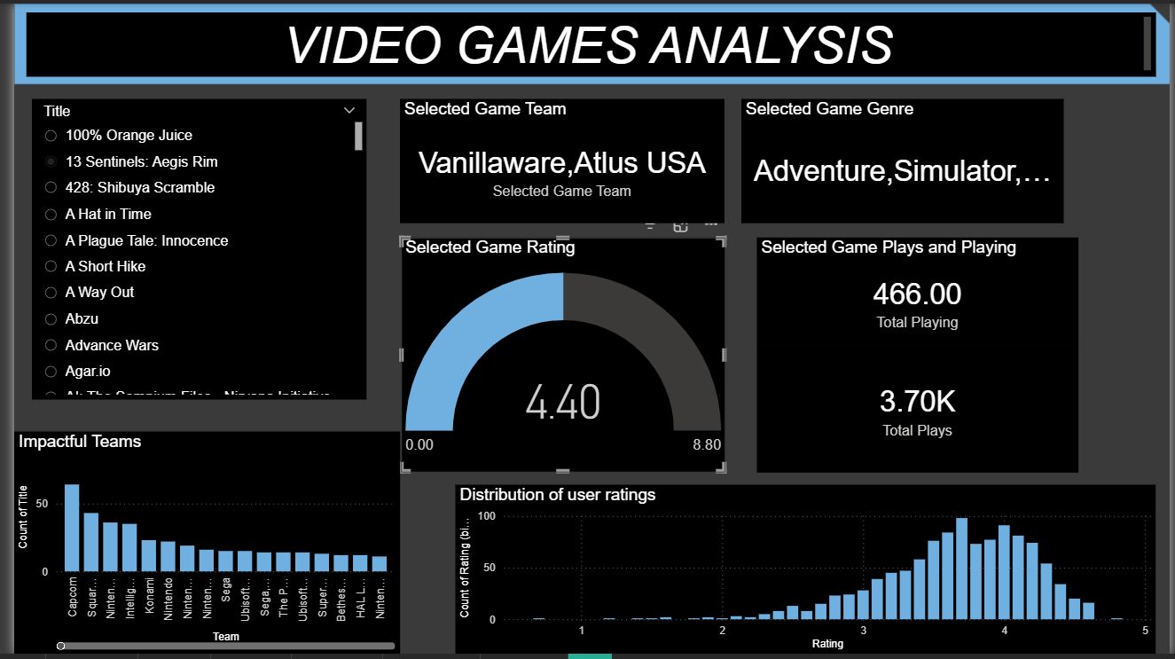
✨ Dashboard Features

Slide 8
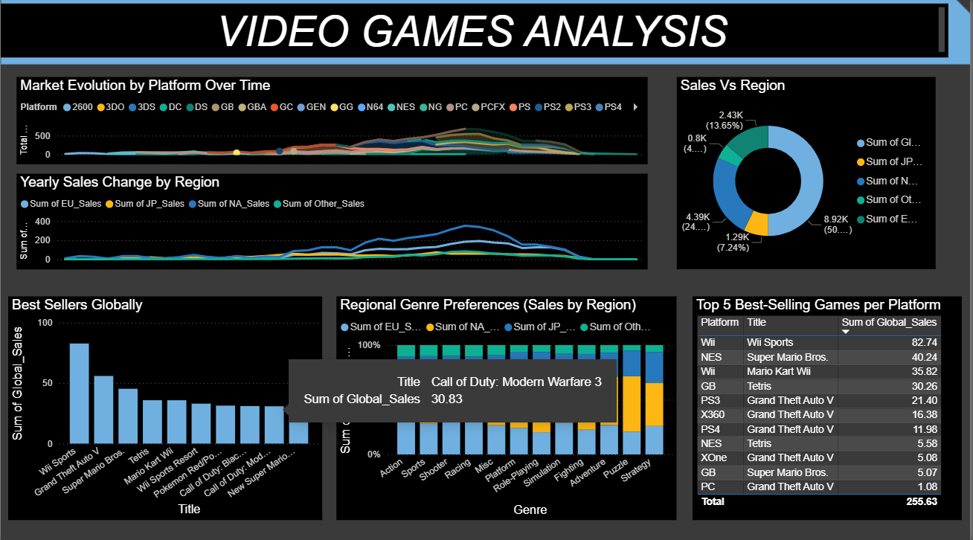
✨ Dashboard Features

Slide 9
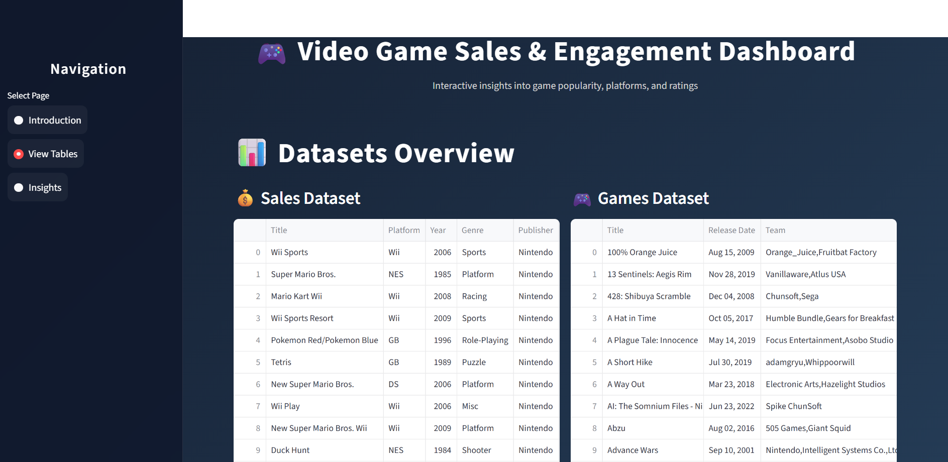
✨ STREAMLIT Features

Slide 10
✅ Conclusion
Data-driven insights help understand gaming industry trends Interactive dashboards improve decision-making

